Slide 1

Sirious Voice Commands
Enabling Webex Teams w/ Voice Recognition
By Samjhana Devkota, Rehan Shah, Siddharth Sharma, Thomas Bergmann, Minju Kim

Slide 2

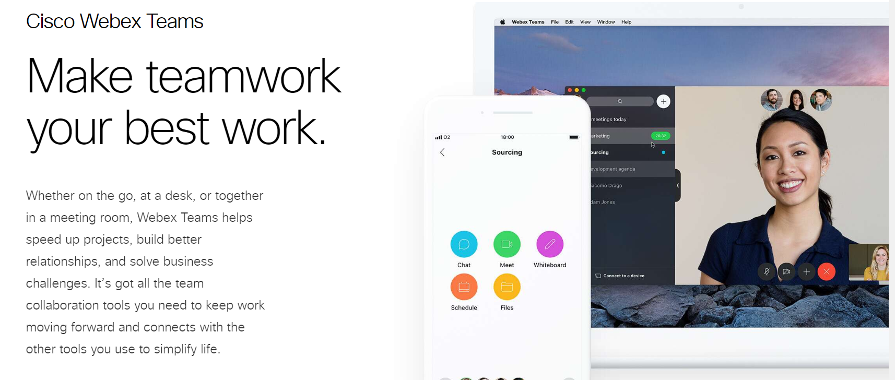

Slide 3



Slide 4
Benefits of voice commands
Enabling Hands Free Technology
Join a Team Meeting whilst driving, Call a Coworker on your bike, Send a message and multitask
Faster and Greater Ease of Use
Users don’t have to navigate through GUI’s
Aiding the Visually-impaired

Slide 5
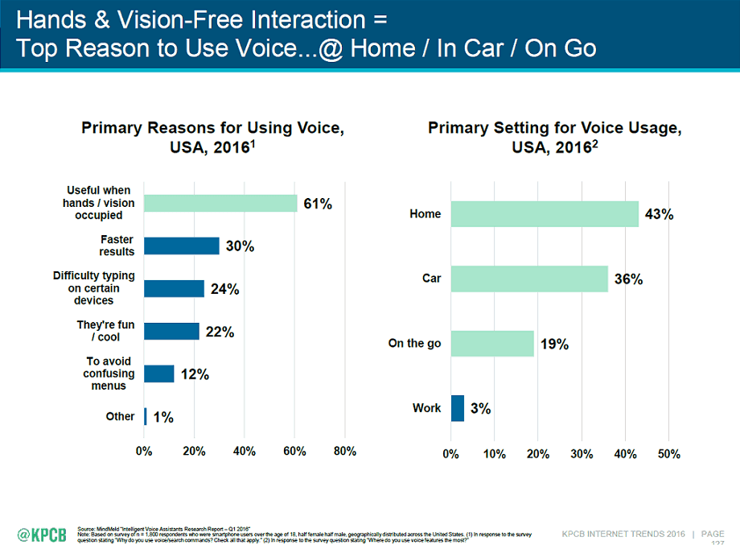

Slide 6

Source:
https://seoexpertbrad.com

Slide 7





Slide 8

Demo
Link: https://www.youtube.com/watch?v=XfMEESsu8h0&feature=youtu.be

Slide 9
Development Process
Two subparts - voice recognition with Siri and using WebEx to start a call
Voice recognition:
Using Siri (SiriKit) would require rewriting code at the application level so chose to use dictation instead for proof of concept
Wrote an AppleScript to use the Dictation app on Mac OS to catch phrases and run a shell script when those phrases are caught
WebEx integration:
Since the WebEx API and SDKs do not tie in to one particular GUI, we used the WebEx browser SDK to initiate a call using the browser as a backup in case working with the Desktop application was not possible
Found protocol handlers for WebEx app on Mac OS which made it possible to use the Desktop application by using the handler and passing the username as an argument

Slide 10
Possible Future Applications
“Call Sid Sharma on Webex Teams”
“Schedule an appointment at noon tomorrow with Sid Sharma and Minju Kim on Webex Teams”
“Message Sid Sharma on Webex Teams that I can’t make the meeting”
“Message in the Server Team space on Webex Teams that the deadline is this week”
“Answer call on Webex Teams”
Integration with Siri

Slide 11
Questions?

Slide 12
Thank you for listening!

